Slide 1
ECEG-5193: Algorithm Analysis and Design
Algorithms of Graph Problems
Shortest Paths

Slide 2
The Shortest Path problem
Given graph and a vertex s find shortest paths from s to all other vertices.
Map routing, robot navigation, urban traffic planning
Optimal pipelining of VLSI chip
Routing of telecommunication messages
Network routing protocols (OSPF, BGP, RIP)
Seam carving, texture mapping, typesetting in TeX!

Slide 3
Variants of Shortest Path
Single-source shortest paths
  G = (V, E) ⇒ find a shortest path from a given source vertex s to each vertex v ∈ V
Single-destination shortest paths
  Find a shortest path to a given destination vertex t from each vertex v
  Reversing the direction of each edge ⇒ single-source
Single-pair shortest path
  Find a shortest path from u to v for given vertices u and v
All-pairs shortest-paths
  Find a shortest path from u to v for every pair of vertices u and v

Slide 4
Shortest path:
The weight of path p =<v₀,v₁,…,v_{k} > is the sum of the weights of its constituent edges:
The cost of the shortest path from s to v is denoted as δ(s, v).

Slide 5
Shortest paths
What is the shortest path from a to d?
B
D
A
C
E

Slide 6
Shortest paths
BFS
B
D
A
C
E

Slide 7
Shortest paths
What is the shortest path from a to d?
2
B
D
3
3
A
1
2
1
C
E
4

Slide 8
Shortest paths
We can still use BFS
2
B
D
3
3
A
1
2
1
C
E
4

Slide 9
Shortest paths
We can still use BFS
2
B
D
B
D
3
3
A
1
2
A
1
C
E
C
E
4

Slide 10
Shortest paths
We can still use BFS
B
D
A
C
E

Slide 11
Shortest paths
What is the problem?
B
D
A
C
E

Slide 12
Shortest paths
Running time is dependent on the weights
B
B
2
100
1
A
50
A
4
C
200
C

Slide 13
Shortest paths
B
B
100
A
50
A
200
C
C

Slide 14
Shortest paths
B
A
C

Slide 15
Shortest paths
B
A
C

Slide 16
Shortest paths
Nothing will change as we expand the frontier until we’ve gone out 100 levels
B
A
C

Slide 17
Paths
?

Slide 18
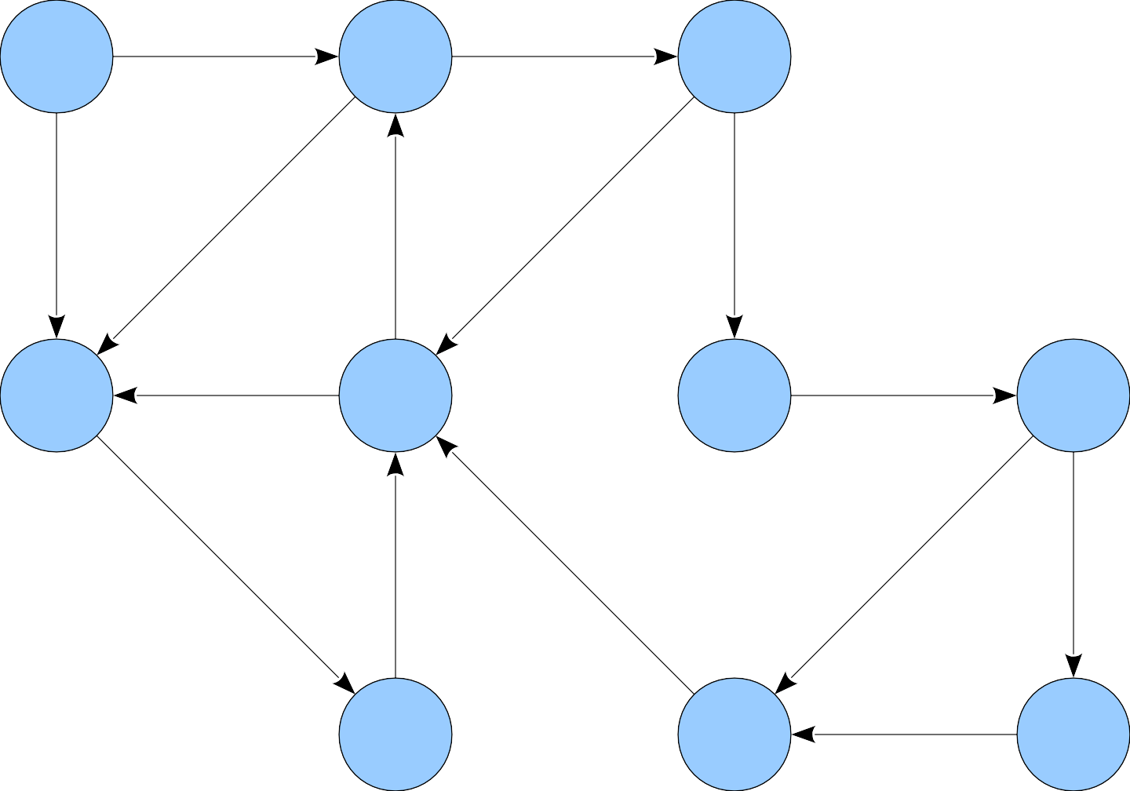
5
3
0
1
3
9
-7
2
1
3
-4
0
-6
-1
1

Slide 19

5
3
★
0
1
3
9
-7
2
1
■
3
-4
0
-6
-1
1

Slide 20
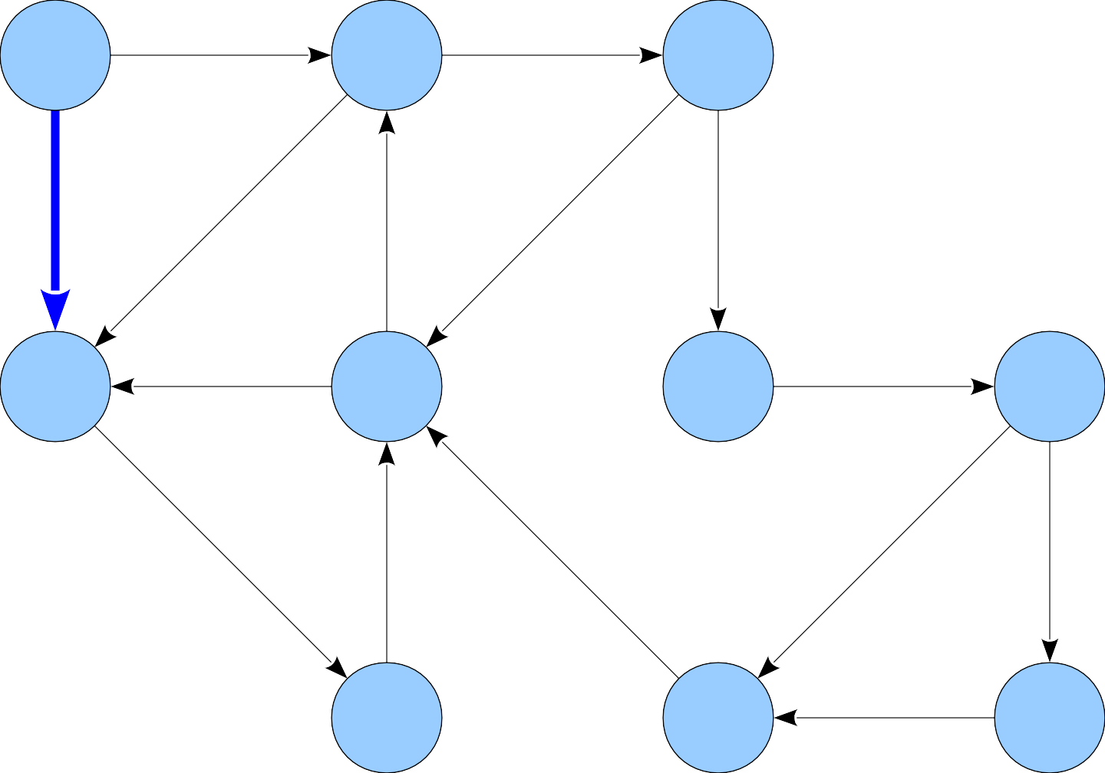
5
3
★
0
1
3
9
-7
2
1
■
3
-4
0
-6
-1
1

Slide 21
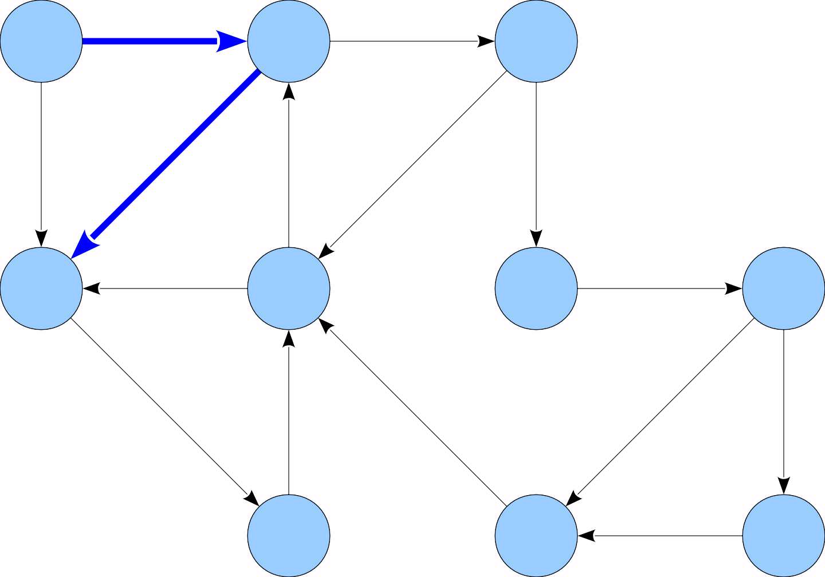
5
3
★
0
1
3
9
-7
2
1
■
3
-4
0
-6
-1
1

Slide 22
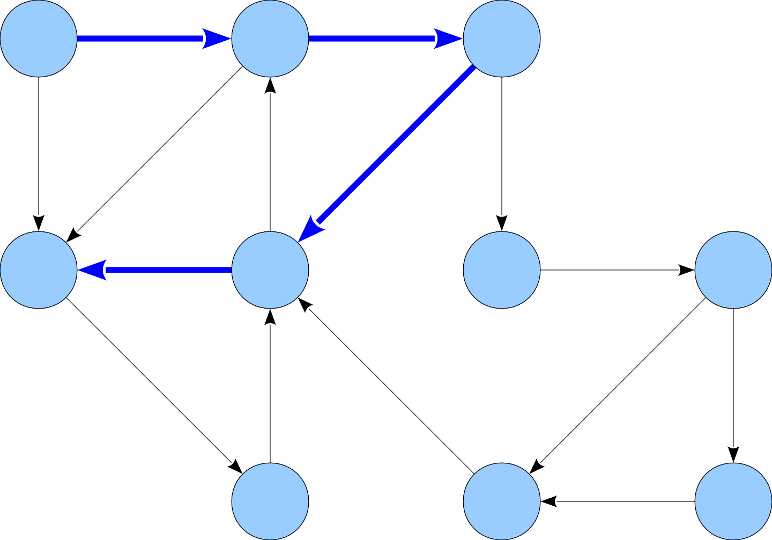
5
3
★
0
1
3
9
-7
2
1
■
1
3
-4
0
-6
-1
1

Slide 23
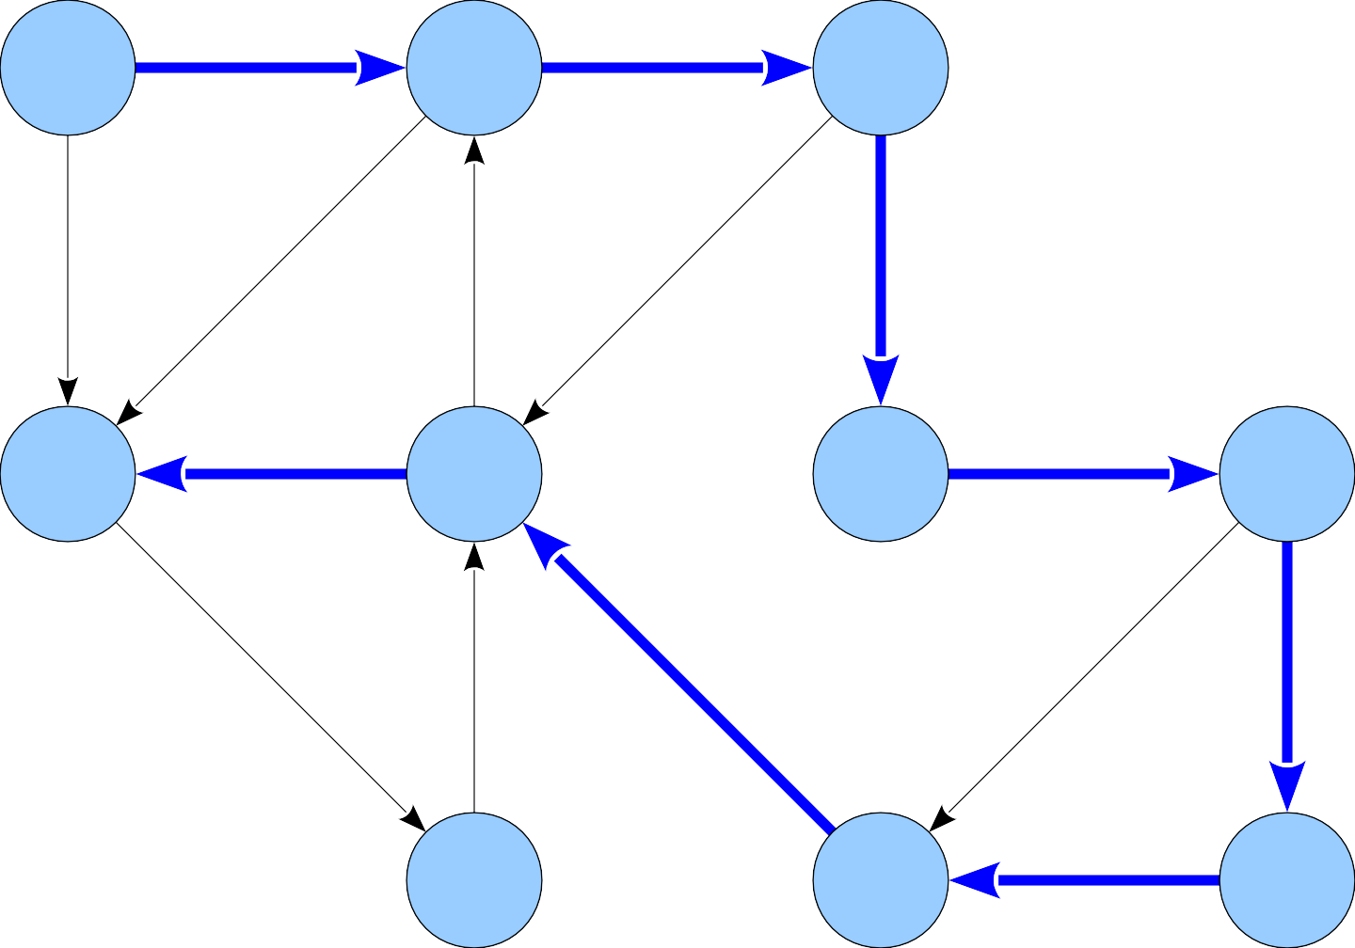
5
3
★
0
1
3
9
-7
2
1
■
3
-4
0
-6
-1
1

Slide 24
A Different Intuition

Slide 25
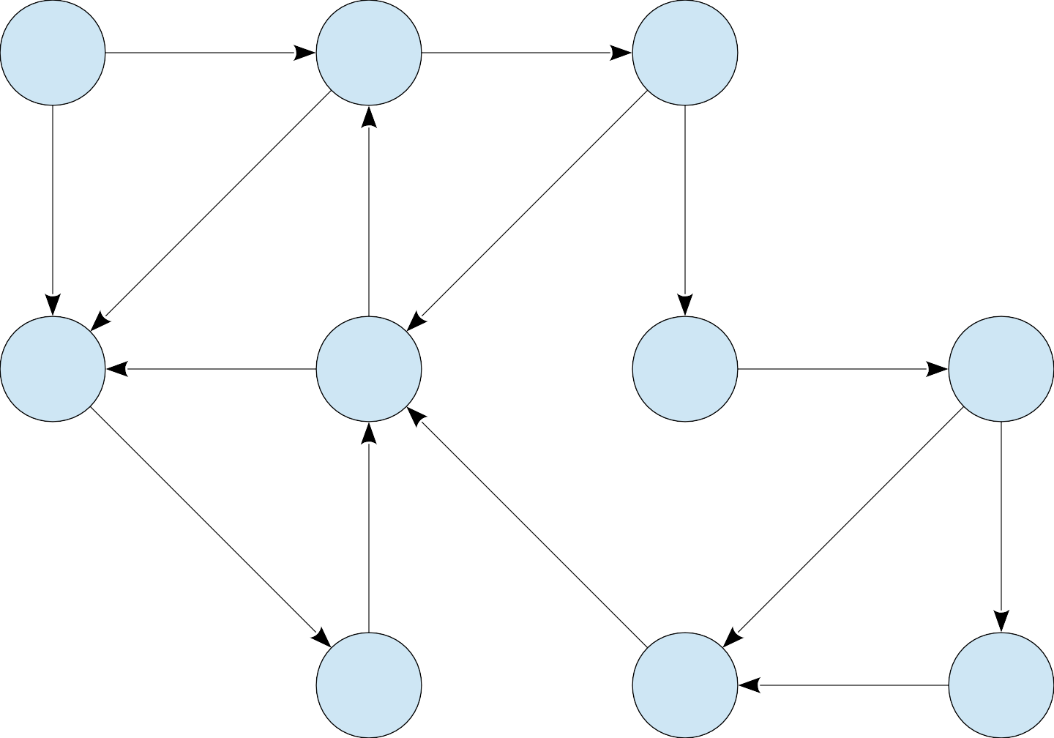
5
3
0
1
3
9
-7
2
1
3
-4
0
-6
-1
1

Slide 26
5
3
0
1
3
9
-7
2
1
3
-4
0
-6
-1
1
Consider paths of length 0.

Slide 27
0
5
3
0
1
3
9
-7
2
1
3
-4
0
-6
-1
1
Consider paths of length 0.

Slide 28
0
5
∞
3
∞
0
1
3
9
-7
2
∞
1
∞
∞
∞
3
-4
0
-6
-1
∞
∞
1
∞
Consider paths of length 0.

Slide 29
0
5
∞
3
∞
0
1
3
9
-7
2
∞
1
∞
∞
∞
3
-4
0
-6
-1
∞
∞
1
∞
Consider paths of length 1.

Slide 30
0
5
5
3
∞
0
1
3
9
-7
2
∞
1
∞
∞
∞
3
-4
0
-6
-1
∞
∞
1
∞
Consider paths of length 1.

Slide 31
0
5
5
3
∞
0
1
3
9
-7
2
3
1
∞
∞
∞
3
-4
0
-6
-1
∞
∞
1
∞
Consider paths of length 1.

Slide 32
0
5
5
3
∞
0
1
3
9
-7
2
3
1
∞
∞
∞
3
-4
0
-6
-1
∞
∞
1
∞
Consider paths of length 2.

Slide 33
0
5
5
3
8
0
1
3
9
-7
2
3
1
∞
∞
∞
3
-4
0
-6
-1
∞
∞
1
∞
Consider paths of length 2.

Slide 34
0
5
5
3
8
0
1
3
9
-7
2
3
1
∞
∞
∞
3
-4
0
-6
-1
2
∞
1
∞
Consider paths of length 2.

Slide 35
0
5
5
3
8
0
1
3
9
-7
2
3
1
∞
∞
∞
3
-4
0
-6
-1
2
∞
1
∞
Consider paths of length 3.

Slide 36
0
5
5
3
8
0
1
3
9
-7
2
3
1
2
1
∞
3
-4
0
-6
-1
2
∞
1
∞
Consider paths of length 3.

Slide 37
0
5
5
3
8
0
1
3
9
-7
2
3
1
2
1
∞
3
-4
0
-6
-1
2
∞
1
∞
Consider paths of length 4.

Slide 38
0
5
5
3
8
0
1
3
9
-7
2
3
1
2
1
3
3
-4
0
-6
-1
2
∞
1
∞
Consider paths of length 4.

Slide 39
0
5
5
3
8
0
1
3
9
-7
2
3
1
2
1
3
3
-4
0
-6
-1
2
∞
1
∞
Consider paths of length 5.

Slide 40
0
5
5
3
8
0
1
3
9
-7
2
3
1
2
1
3
3
-4
0
-6
-1
2
-1
1
-3
Consider paths of length 5.

Slide 41
0
5
5
3
8
0
1
3
9
-7
2
3
1
2
1
3
3
-4
0
-6
-1
2
-1
1
-3
Consider paths of length 6.

Slide 42
0
5
5
3
8
0
1
3
9
-7
2
3
1
2
1
3
3
-4
0
-6
-1
2
-2
1
-3
Consider paths of length 6.

Slide 43
0
5
5
3
8
0
1
3
9
-7
2
3
1
2
1
3
3
-4
0
-6
-1
2
-2
1
-3
Consider paths of length 7.

Slide 44
0
5
5
3
8
0
1
3
9
-7
2
3
1
1
1
3
3
-4
0
-6
-1
2
-2
1
-3
Consider paths of length 7.

Slide 45
0
5
5
3
8
0
1
3
9
-7
2
3
1
1
1
3
3
-4
0
-6
-1
2
-2
1
-3
Consider paths of length 8.

Slide 46
0
5
5
3
8
0
1
3
9
-7
2
2
1
1
1
3
3
-4
0
-6
-1
2
-2
1
-3
Consider paths of length 8.

Slide 47
0
5
5
3
8
0
1
3
9
-7
2
2
1
1
1
3
3
-4
0
-6
-1
2
-2
1
-3
Consider paths of length 9.

Slide 48
0
5
5
3
8
0
1
3
9
-7
2
2
1
1
1
3
3
-4
0
-6
-1
1
-2
1
-3
Consider paths of length 9.

Slide 49
0
5
5
3
8
0
1
3
9
-7
2
2
1
1
1
3
3
-4
0
-6
-1
1
-2
1
-3
Consider paths of length 10+.

Slide 50
Shortest Paths in DAGs
  Topologically sort vertices in G;
  Initialize(G, s);
  for each u in V[G] (in order)
  do
  for each v in Adj[u]
  do
  Relax(u, v, w)
  od
  od

Slide 51
Example
6
1
r
s
t
u
v
w
∞
5
0
2
∞
7
∞
–1
∞
–2
∞
4
3
2

Slide 52
Example
6
1
r
s
t
u
v
w
∞
5
0
2
∞
7
∞
–1
∞
–2
∞
4
3
2

Slide 53
Example
6
1
r
s
t
u
v
w
∞
5
0
2
2
7
6
–1
∞
–2
∞
4
3
2

Slide 54
Example
6
1
r
s
t
u
v
w
∞
5
0
2
2
7
6
–1
6
–2
4
4
3
2

Slide 55
Example
6
1
r
s
t
u
v
w
∞
5
0
2
2
7
6
–1
5
–2
4
4
3
2

Slide 56
Example
6
1
r
s
t
u
v
w
∞
5
0
2
2
7
6
–1
5
–2
3
4
3
2

Slide 57
Example
6
1
r
s
t
u
v
w
∞
5
0
2
2
7
6
–1
5
–2
3
4
3
2

Slide 58
Single source shortest paths
Dijkstra’s Algorithm

Slide 59
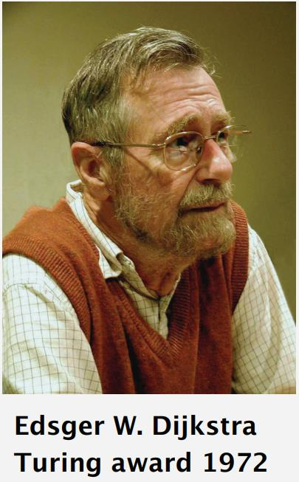
Edsger W. Dijkstra: Select Quotes
“Do only what only you can do.”
“The use of COBOL cripples the mind; its teaching should, therefore, be regarded as a criminal offence.”
“It is practically impossible to teach good programming to students that have had a prior exposure to BASIC: as potential programmers they are mentally mutilated beyond hope of regeneration.”

Slide 60


Slide 61
Dijkstra’s algorithm
Solves the single-source shortest-paths problem on a weighted, directed graph G = (V, E)
  we assume that w(u, v) ≥ 0 for each edge (u, v) ∈ E.
Maintains a set S of vertices whose final shortest-path weights from the source s have already been determined.
Repeatedly selects the vertex u ∈ V - S with the minimum shortest-path estimate, adds u to S, and relaxes all edges leaving u.
We can use a min-priority queue Q of vertices, keyed by their d values

Slide 62
Dijkstra’s algorithm
The algorithm proceeds in stages.
At each stage, the algorithm
  selects a vertex v, which has the smallest distance D_{v} among all the unknown vertices, and
  declares that the shortest path from s to v is known.
  then for the adjacent nodes of v (which are denoted as w) D_{w} is updated with new distance information
How do we change D_{w}?
  If its current value is larger than D_{v} + C_{v,w} we change it.

Slide 63
Dijkstra’s algorithm
DIJKSTRA(G, w, s)
1
2
3
4
5
6
7
8
INITIALIZE-SINGLE-SOURCE(G, s)
S = φ
Q = G.V
while Q≠φ
u = EXTRACT-MIN(Q)
S = S ∪ { u }
for each vertex v ∈ G.Adj[u]
RELAX(u, v, w)

Slide 64
Relaxation
The process of relaxing an edge (u,v) consists of testing whether we can improve the shortest path to v found so far by going through u and, if so, updating d[v].
relax(u, v)
if d[v] > d[u]+w(u,v) then
d[v] ← d[u]+w(u,v)
π[v] ← u

Slide 65
u
v
u
v
2
2
5
9
5
6
RELAX(u,v)
RELAX(u,v)
u
v
u
v
2
2
5
7
5
6
(a)
(b)
a) Because d[v] > d[u] + w(u, v) prior to relaxation, the value of d[v] decreases.
b) Here, d[v] ≤ d[u] + w(u, v) before the relaxation step, so d[v] is unchanged by relaxation.

Slide 66
u
v
1
8
8
10
9
s
0
2
3
4
6
7
5
8
8
2
x
y
(a)
Notes:
Single Source Shortest Path Problem

Slide 67
u
v
1
10/s
8
10
9
s
0
2
3
4
6
7
5
5/s
8
2
x
y
(b)
(s,x) is the shortest path using one edge. It is also the shortest path from s to x.

Slide 68
u
v
1
8/x
14/x
10
9
s
0
2
3
4
6
7
5
5/s
7/x
2
x
y
(c)

Slide 69
u
v
1
8/x
13/y
10
9
s
0
2
3
4
6
7
5
5/s
7/x
2
x
y
(d)

Slide 70
u
v
1
8/x
9/u
10
9
s
0
2
3
4
6
7
5
5/s
7/x
2
x
y
(e)

Slide 71
u
v
1
8/x
9/u
10
9
s
0
2
3
4
6
7
5
5/s
7/x
2
x
y
(f)
Backtracking: v-u-x-s

Slide 72
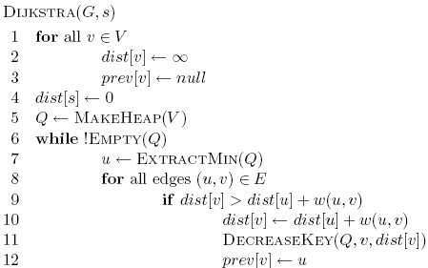
Dijkstra’s algorithm

Slide 73
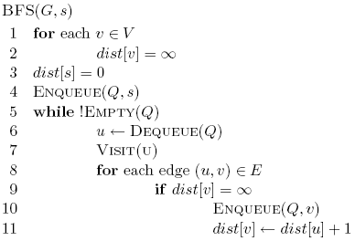
Dijkstra’s algorithm

Slide 74
Dijkstra’s algorithm
prev keeps track of
the shortest path

Slide 75
Dijkstra’s algorithm

Slide 76
Dijkstra’s algorithm

Slide 77
Dijkstra’s algorithm

Slide 78
3
B
D
3
1
A
1
2
1
C
E
4

Slide 79
∞
∞
3
B
D
3
∞
1
A
1
2
∞
1
C
E
∞
4

Slide 80
Heap
A 0
B ∞
C ∞
D ∞
E ∞
∞
∞
3
B
D
3
0
1
A
1
2
∞
1
C
E
∞
4

Slide 81
Heap
B ∞
C ∞
D ∞
E ∞
∞
∞
3
B
D
3
0
1
A
1
2
∞
1
C
E
∞
4

Slide 82
Heap
B ∞
C ∞
D ∞
E ∞
∞
∞
3
B
D
3
0
1
A
1
2
∞
1
C
E
∞
4

Slide 83
Heap
C 1
B ∞
D ∞
E ∞
∞
∞
3
B
D
3
0
1
A
1
2
1
1
C
E
∞
4

Slide 84
Heap
C 1
B ∞
D ∞
E ∞
∞
∞
3
B
D
3
0
1
A
1
2
1
1
C
E
∞
4

Slide 85
Heap
C 1
B 3
D ∞
E ∞
3
∞
3
B
D
3
0
1
A
1
2
1
1
C
E
∞
4

Slide 86
Heap
C 1
B 3
D ∞
E ∞
3
∞
3
B
D
3
0
1
A
1
2
1
1
C
E
∞
4

Slide 87
Heap
B 3
D ∞
E ∞
3
∞
3
B
D
3
0
1
A
1
2
1
1
C
E
∞
4

Slide 88
Heap
B 3
D ∞
E ∞
3
∞
3
B
D
3
0
1
A
1
2
1
1
C
E
∞
4

Slide 89
Heap
B 3
D ∞
E ∞
3
∞
3
B
D
3
0
1
A
1
2
1
1
C
E
∞
4

Slide 90
Heap
B 2
D ∞
E ∞
2
∞
3
B
D
3
0
1
A
1
2
1
1
C
E
∞
4

Slide 91
Heap
B 2
D ∞
E ∞
2
∞
3
B
D
3
0
1
A
1
2
1
1
C
E
∞
4

Slide 92
Heap
B 2
E 5
D ∞
2
∞
3
B
D
3
0
1
A
1
2
1
1
C
E
5
4

Slide 93
Heap
B 2
E 5
D ∞
2
∞
3
B
D
3
0
1
A
1
2
1
1
C
E
5
4

Slide 94
Heap
B 2
E 5
D ∞
2
∞
3
B
D
3
0
All nodes reachable from starting node within a given distance
1
A
1
2
1
1
C
E
5
4

Slide 95
Heap
E 3
D 5
2
5
3
B
D
3
0
1
A
1
2
1
1
C
E
3
4

Slide 96
Heap
D 5
2
5
3
B
D
3
0
1
A
1
2
1
1
C
E
3
4

Slide 97
Heap
2
5
3
B
D
3
0
1
A
1
2
1
1
C
E
3
4

Slide 98
Heap
2
5
3
B
D
0
1
A
1
1
1
C
E
3

Slide 99
Running time?

Slide 100
Running time?
1 call to MakeHeap

Slide 101
Running time?
|V| iterations

Slide 102
Running time?
|V| calls

Slide 103
Running time?
O(|E|) calls

Slide 104
Running time?
Depends on the heap implementation
1 MakeHeap
|V| ExtractMin
|E| DecreaseKey
Total
Array
O(|V|)
O(|V|²)
O(|E|)
O(|V|²)
Bin heap
O(|V|)
O(|V| log |V|)
O(|E| log |V|)
O((|V|+|E|) log |V|)
O(|E| log |V|)

Slide 105
Running time?
Depends on the heap implementation
1 MakeHeap
|V| ExtractMin
|E| DecreaseKey
Total
Array
O(|V|)
O(|V|²)
O(|E|)
O(|V|²)
Bin heap
O(|V|)
O(|V| log |V|)
O(|E| log |V|)
O((|V|+|E|) log |V|)
O(|E| log |V|)
Is this an improvement?
If |E| < |V|² / log |V|

Slide 106
Running time?
Depends on the heap implementation
1 MakeHeap
|V| ExtractMin
|E| DecreaseKey
Total
Array
O(|V|)
O(|V|²)
O(|E|)
O(|V|²)
Bin heap
O(|V|)
O(|V| log |V|)
O(|E| log |V|)
O((|V|+|E|) log |V|)
O(|E| log |V|)
Fib heap
O(|V|)
O(|V| log |V|)
O(|E|)
O(|V| log |V| + |E|)

Slide 107
Is Dijkstra’s algorithm correct?
Invariant:

Slide 108
Is Dijkstra’s algorithm correct?
Invariant: For every vertex removed from the heap, dist[v] is the actual shortest distance from s to v

Slide 109
Is Dijkstra’s algorithm correct?
Invariant: For every vertex removed from the heap, dist[v] is the actual shortest distance from s to v
  The only time a vertex gets visited is when the distance from s to that vertex is smaller than the distance to any remaining vertex
  Therefore, there cannot be any other path that hasn’t been visited already that would result in a shorter path

Slide 110
Bounding the distance
Another invariant: For each vertex v, dist[v] is an upper bound on the actual shortest distance
  start of at ∞
  only update the value if we find a shorter distance
An update procedure

Slide 111
Can we ever go wrong applying this update rule?
  We can apply this rule as many times as we want and will never underestimate dist[v]
When will dist[v] be right?
  If u is along the shortest path to v and dist[u] is correct

Slide 112
dist[v] will be right if u is along the shortest path to v and dist[u] is correct
Consider the shortest path from s to v
s
p₁
p₂
p₃
p_{k}
v

Slide 113
dist[v] will be right if u is along the shortest path to v and dist[u] is correct
What happens if we update all of the vertices with the above update?
s
p₁
p₂
p₃
p_{k}
v

Slide 114
dist[v] will be right if u is along the shortest path to v and dist[u] is correct
What happens if we update all of the vertices with the above update?
s
p₁
p₂
p₃
p_{k}
v
correct

Slide 115
dist[v] will be right if u is along the shortest path to v and dist[u] is correct
What happens if we update all of the vertices with the above update?
s
p₁
p₂
p₃
p_{k}
v
correct
correct

Slide 116
dist[v] will be right if u is along the shortest path to v and dist[u] is correct
Does the order that we update the vertices matter?
s
p₁
p₂
p₃
p_{k}
v
correct
correct

Slide 117
dist[v] will be right if u is along the shortest path to v and dist[u] is correct
How many times do we have to do this for vertex p_{i} to have the correct shortest path from s?
  i times
s
p₁
p₂
p₃
p_{k}
v

Slide 118
dist[v] will be right if u is along the shortest path to v and dist[u] is correct
How many times do we have to do this for vertex p_{i} to have the correct shortest path from s?
  i times
s
p₁
p₂
p₃
p_{k}
v
correct
correct

Slide 119
dist[v] will be right if u is along the shortest path to v and dist[u] is correct
How many times do we have to do this for vertex p_{i} to have the correct shortest path from s?
  i times
s
p₁
p₂
p₃
p_{k}
v
correct
correct
correct

Slide 120
dist[v] will be right if u is along the shortest path to v and dist[u] is correct
How many times do we have to do this for vertex p_{i} to have the correct shortest path from s?
  i times
s
p₁
p₂
p₃
p_{k}
v
correct
correct
correct
correct

Slide 121
dist[v] will be right if u is along the shortest path to v and dist[u] is correct
How many times do we have to do this for vertex p_{i} to have the correct shortest path from s?
  i times
s
p₁
p₂
p₃
p_{k}
v
…
correct
correct
correct
correct

Slide 122
dist[v] will be right if u is along the shortest path to v and dist[u] is correct
What is the longest (vetex-wise) the path from s to any node v can be?
  |V| - 1 edges/vertices
s
p₁
p₂
p₃
p_{k}
v
…
correct
correct
correct
correct

Slide 123
What about Dijkstra’s on negative weights?

Slide 124
Dijkstra’s Algorithm
What about Negative Weights?
1
1
B
D
A
5
10
-10
C
E

Slide 125
Dijkstra’s Algorithm
What about Negative Weights?
1
1
B
D
A
5
10
-10
C
E

Slide 126
Dijkstra’s Algorithm
What about Negative Weights?
Dijkstra’s algorithm only works for positive edge weights
1
1
B
D
A
5
10
C
E

Slide 127
Dijkstra and Negative Weights
1
3
2
5
-3
4
3
2

Slide 128
Dijkstra and Negative Weights
0
3
3
1
2
5
-3
5
∞
4
3
2

Slide 129
Dijkstra and Negative Weights
0
3
3
1
2
5
-3
5
∞
4
3
2

Slide 130
Dijkstra and Negative Weights
0
3
3
1
2
5
-3
5
∞
4
3
2

Slide 131
Dijkstra and Negative Weights
0
3
3
1
2
5
-3
5
7
4
3
2

Slide 132
Dijkstra and Negative Weights
0
3
3
1
2
5
-3
5
7
4
3
2

Slide 133
Dijkstra and Negative Weights
0
3
3
1
2
5
-3
5
7
4
3
2
It worked on negative edges.
Does it always work?

Slide 134
Dijkstra and Negative Weights
1
3
2
5
-10
4
3
2

Slide 135
Dijkstra and Negative Weights
0
3
3
1
2
5
-10
5
∞
4
3
2

Slide 136
Dijkstra and Negative Weights
0
3
3
1
2
5
-10
5
∞
4
3
2

Slide 137
Dijkstra and Negative Weights
0
3
3
1
2
5
-10
5
∞
4
3
2

Slide 138
Dijkstra and Negative Weights
0
3
3
1
2
5
-10
5
7
4
3
2

Slide 139
Dijkstra and Negative Weights
-3
0
3
3 .
1
2
5
-10
5
7
4
3
2

Slide 140
Bellman-Ford Algorithm for
Single Source Shortest Paths

Slide 141
Bellman-Ford Algorithm for Single Source Shortest Paths
More general than Dijkstra’s algorithm:
    Edge-weights can be negative
Performs |V|-1 relaxation passes; relax every edge at each pass

Slide 142
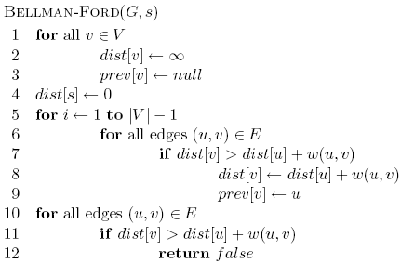
Bellman-Ford algorithm

Slide 143
Bellman-Ford algorithm
Initialize all the distances

Slide 144
Bellman-Ford algorithm
iterate over all edges/vertices and apply update rule

Slide 145
Bellman-Ford algorithm

Slide 146
Bellman-Ford algorithm
check for negative cycles

Slide 147
Bellman-Ford Algorithm
Running time = O(VxE)

Slide 148
Exercise: Negative cycles
What is the shortest path from a to e?
1
1
B
D
A
5
10
-10
C
E
3

Slide 149
Example: Bellman-Ford algorithm
1
3
2
5
-10
4
3
2
Edges: (3,2) (4,3) (1,4) (1,2)
Need to relax |V|-1 = 3 times

Slide 150
Example: Bellman-Ford algorithm
0
∞
1
3
2
RELAX
3 times
5
-10
∞
∞
4
3
2
Edges: (3,2) (4,3) (1,4) (1,2)

Slide 151
Example: Bellman-Ford algorithm
0
∞
1
3
2
RELAX
1 of 3
5
-10
∞
∞
4
3
2
Edges: (3,2) (4,3) (1,4) (1,2)

Slide 152
Example: Bellman-Ford algorithm
0
∞
1
3
2
RELAX
1 of 3
5
-10
∞
∞
4
3
2
Edges: (3,2) (4,3) (1,4) (1,2)

Slide 153
Example: Bellman-Ford algorithm
0
∞
1
3
2
RELAX
1 of 3
5
-10
5
∞
4
3
2
Edges: (3,2) (4,3) (1,4) (1,2)

Slide 154
Example: Bellman-Ford algorithm
0
3
1
3
2
RELAX
1 of 3
5
-10
5
∞
4
3
2
Edges: (3,2) (4,3) (1,4) (1,2)

Slide 155
Example: Bellman-Ford algorithm
0
3
1
3
2
RELAX
2 of 3
5
-10
5
∞
4
3
2
Edges: (3,2) (4,3) (1,4) (1,2)

Slide 156
Example: Bellman-Ford algorithm
0
3
1
3
2
RELAX
2 of 3
5
-10
5
7
4
3
2
Edges: (3,2) (4,3) (1,4) (1,2)

Slide 157
Example: Bellman-Ford algorithm
0
3
1
3
2
RELAX
2 of 3
5
-10
5
7
4
3
2
Edges: (3,2) (4,3) (1,4) (1,2)

Slide 158
Example: Bellman-Ford algorithm
0
3
1
3
2
RELAX
2 of 3
5
-10
5
7
4
3
2
Edges: (3,2) (4,3) (1,4) (1,2)

Slide 159
Example: Bellman-Ford algorithm
0
-3
1
3
2
RELAX
3 of 3
5
-10
5
7
4
3
2
Edges: (3,2) (4,3) (1,4) (1,2)

Slide 160
Example: Bellman-Ford algorithm
0
-3
1
3
2
RELAX
3 of 3
5
-10
5
7
4
3
2
Edges: (3,2) (4,3) (1,4) (1,2)

Slide 161
Example: Bellman-Ford algorithm
0
-3
1
3
2
RELAX
3 of 3
5
-10
5
7
4
3
2
Edges: (3,2) (4,3) (1,4) (1,2)

Slide 162
Example: Bellman-Ford algorithm
0
-3
1
3
2
RELAX
3 of 3
5
-10
5
7
4
3
2
Edges: (3,2) (4,3) (1,4) (1,2)

Slide 163
Example: Bellman-Ford algorithm
0
-3
1
3
2
5
-10
5
7
4
3
2

Slide 164
Bellman-Ford algorithm
Exercise

Slide 165
Bellman-Ford algorithm
10
How many edges is the shortest path from s to:
S
A
8
1
G
-4
B
A:
2
1
1
-2
C
F
-1
3
E
D
-1

Slide 166
Bellman-Ford algorithm
10
How many edges is the shortest path from s to:
S
A
8
1
G
-4
B
A:
3
2
1
1
-2
C
F
-1
3
E
D
-1

Slide 167
Bellman-Ford algorithm
10
How many edges is the shortest path from s to:
S
A
8
1
G
-4
B
A:
3
2
1
1
-2
B:
F
C
-1
3
E
D
-1

Slide 168
Bellman-Ford algorithm
10
How many edges is the shortest path from s to:
S
A
8
1
G
-4
B
A:
3
2
1
1
-2
B:
5
F
C
-1
3
E
D
-1

Slide 169
Bellman-Ford algorithm
10
How many edges is the shortest path from s to:
S
A
8
1
G
-4
B
A:
3
2
1
1
-2
B:
5
F
C
-1
3
E
D
D:
-1

Slide 170
Bellman-Ford algorithm
10
How many edges is the shortest path from s to:
S
A
8
1
G
-4
B
A:
3
2
1
1
-2
B:
5
F
C
-1
3
E
D
D:
7
-1

Slide 171
Bellman-Ford Algorithm
Example

Slide 172
Bellman-Ford algorithm
0
∞
10
S
A
Iteration: 0
8
1
∞
∞
G
-4
B
2
1
1
-2
C
∞
F
∞
-1
3
E
D
-1
∞
∞

Slide 173
Bellman-Ford algorithm
0
10
10
S
A
Iteration: 1
8
1
∞
8
G
-4
B
2
1
1
-2
C
∞
F
∞
-1
3
E
D
-1
∞
∞

Slide 174
Bellman-Ford algorithm
0
10
10
S
A
Iteration: 2
8
1
∞
8
G
-4
B
2
1
1
-2
C
∞
F
9
-1
3
E
D
-1
12
∞

Slide 175
Bellman-Ford algorithm
0
5
10
S
A
Iteration: 3
8
1
10
8
G
-4
B
A has the correct distance and path
2
1
1
-2
C
∞
F
9
-1
3
E
D
-1
8
∞

Slide 176
Bellman-Ford algorithm
0
5
10
S
A
Iteration: 4
8
1
6
8
G
-4
B
2
1
1
-2
C
11
F
9
-1
3
E
D
-1
7
∞

Slide 177
Bellman-Ford algorithm
0
5
10
S
A
Iteration: 5
8
1
5
8
G
-4
B
B has the correct distance and path
2
1
1
-2
C
7
F
9
-1
3
E
D
-1
7
14

Slide 178
Bellman-Ford algorithm
0
5
10
S
A
Iteration: 6
8
1
5
8
G
-4
B
2
1
1
-2
C
6
F
9
-1
3
E
D
-1
7
10

Slide 179
Bellman-Ford algorithm
0
5
10
S
A
Iteration: 7
8
1
5
8
G
-4
B
D (and all other nodes) have the correct distance and path
2
1
1
-2
C
6
F
9
-1
3
E
D
-1
7
9

Slide 180
Bellman-Ford Algorithm
Example:
Negative cycles

Slide 181
Bellman-Ford: Negative cycles
1
4
2
RELAX
3 times
5
5
-10
4
3
3
Edges: (3,2)(4,3)(1,4)(1,2)(2,4)

Slide 182
Bellman-Ford: Negative cycles
0
∞
1
4
2
RELAX
3 times
5
5
-10
∞
∞
4
3
3
Edges: (3,2)(4,3)(1,4)(1,2)(2,4)

Slide 183
Bellman-Ford: Negative cycles
0
∞
1
4
2
RELAX
1 of 3
5
5
-10
∞
∞
4
3
3
Edges: (3,2)(4,3)(1,4)(1,2)(2,4)

Slide 184
Bellman-Ford: Negative cycles
0
∞
1
4
2
RELAX
1 of 3
5
5
-10
∞
∞
4
3
3
Edges: (3,2)(4,3)(1,4)(1,2)(2,4)

Slide 185
Bellman-Ford: Negative cycles
0
∞
1
4
2
RELAX
1 of 3
5
5
-10
5
∞
4
3
3
Edges: (3,2)(4,3)(1,4)(1,2)(2,4)

Slide 186
Bellman-Ford: Negative cycles
0
4
1
4
2
RELAX
1 of 3
5
5
-10
5
∞
4
3
3
Edges: (3,2)(4,3)(1,4)(1,2)(2,4)

Slide 187
Bellman-Ford: Negative cycles
0
4
1
4
2
RELAX
1 of 3
5
5
-10
5
∞
4
3
3
Edges: (3,2)(4,3)(1,4)(1,2)(2,4)

Slide 188
Bellman-Ford: Negative cycles
0
4
1
4
2
RELAX
2 of 3
5
5
-10
5
∞
4
3
3
Edges: (3,2)(4,3)(1,4)(1,2)(2,4)

Slide 189
Bellman-Ford: Negative cycles
0
4
1
4
2
RELAX
2 of 3
5
5
-10
5
8
4
3
3
Edges: (3,2)(4,3)(1,4)(1,2)(2,4)

Slide 190
Bellman-Ford: Negative cycles
0
4
1
4
2
RELAX
2 of 3
5
5
-10
5
8
4
3
3
Edges: (3,2)(4,3)(1,4)(1,2)(2,4)

Slide 191
Bellman-Ford: Negative cycles
0
4
1
4
2
RELAX
2 of 3
5
5
-10
5
8
4
3
3
Edges: (3,2)(4,3)(1,4)(1,2)(2,4)

Slide 192
Bellman-Ford: Negative cycles
0
4
1
4
2
RELAX
3 of 3
5
5
-10
5
8
4
3
3
Edges: (3,2)(4,3)(1,4)(1,2)(2,4)

Slide 193
Bellman-Ford: Negative cycles
0
-2
1
4
2
RELAX
3 of 3
5
5
-10
5
8
4
3
3
Edges: (3,2)(4,3)(1,4)(1,2)(2,4)

Slide 194
Bellman-Ford: Negative cycles
0
-2
1
4
2
RELAX
3 of 3
5
5
-10
5
8
4
3
3
Edges: (3,2)(4,3)(1,4)(1,2)(2,4)

Slide 195
Bellman-Ford: Negative cycles
0
-2
1
4
2
RELAX
3 of 3
5
5
-10
5
8
4
3
3
Edges: (3,2)(4,3)(1,4)(1,2)(2,4)

Slide 196
Bellman-Ford: Negative cycles
0
-2
1
4
2
RELAX
3 of 3
5
5
-10
5
8
4
3
3
Edges: (3,2)(4,3)(1,4)(1,2)(2,4)

Slide 197
Bellman-Ford: Negative cycles
0
-2
1
4
2
RELAX
3 of 3
5
5
-10
3
8
4
3
3
Edges: (3,2)(4,3)(1,4)(1,2)(2,4)

Slide 198
Bellman-Ford: Negative cycles
0
-2
1
4
2
RELAX
Done!
5
5
-10
3
8
4
3
3

Slide 199
Bellman-Ford: Negative cycles
0
-2
1
4
2
RELAX
One more
5
5
-10
3
8
4
3
3
Edges: (3,2)(4,3)(1,4)(1,2)(2,4)

Slide 200
Bellman-Ford: Negative cycles
0
-2
1
4
2
RELAX
One more
5
5
-10
3
6
4
3
3
Edges: (3,2)(4,3)(1,4)(1,2)(2,4)

Slide 201
Bellman-Ford: Negative cycles
0
-2
1
4
2
RELAX
One more
5
5
-10
3
6
4
3
3
Edges: (3,2)(4,3)(1,4)(1,2)(2,4)

Slide 202
Bellman-Ford: Negative cycles
0
-2
1
4
2
RELAX
One more
5
5
-10
3
6
4
3
3
Edges: (3,2)(4,3)(1,4)(1,2)(2,4)

Slide 203
Bellman-Ford: Negative cycles
0
-2
1
4
2
RELAX
One more
5
5
-10
3
6
4
3
3
Edges: (3,2)(4,3)(1,4)(1,2)(2,4)

Slide 204
Bellman-Ford: Negative cycles
0
-2
1
4
2
RELAX
again
5
5
-10
3
6
4
3
3
= 5 + 3 - 10
= - 2

Slide 205
Correctness of Bellman-Ford
Loop invariant:

Slide 206
Correctness of Bellman-Ford
Loop invariant: After iteration i, all vertices with shortest paths from s of length i edges or less have correct distances

Slide 207
Runtime of Bellman-Ford
O(|V| |E|)

Slide 208
Runtime of Bellman-Ford
Can you modify the algorithm to run faster (in some circumstances)?

Slide 209
Dynamic Programming
Bellman-Ford

Slide 210
Bellman-Ford Algorithm
We maintain a list d^{(k)} of length n for each k = 0, 1, …, |V|-1.
d^{(k)}[b] is the cost of the shortest path from s to b with at most k edges.
s
u
v
t
d⁽⁰⁾
0
∞
∞
∞
0
2
∞
s
u
d⁽¹⁾
1
We know k = 0 i.e. shortest paths to each vertex with at most 0 edges in it.
2
d⁽²⁾
5
d⁽³⁾
t
v
∞
-2
∞

Slide 211
Bellman-Ford Algorithm
We maintain a list d^{(k)} of length n for each k = 0, 1, …, |V|-1.
d^{(k)}[b] is the cost of the shortest path from s to b with at most k edges.
s
u
v
t
d⁽⁰⁾
0
∞
∞
∞
0
2
∞
s
u
d⁽¹⁾
1
2
d⁽²⁾
5
We will use table d⁽⁰⁾ to fill in d⁽¹⁾. More generally, we will use table d^{(k-1)} to fill in d^{(k)}.
d⁽³⁾
t
v
∞
-2
∞

Slide 212
Bellman-Ford Algorithm
How do we use d^{(k-1)} to fill in d^{(k)}[b]?
Recall d^{(k)}[b] is the cost of the shortest path from s to b with at most k edges.
Case 1: the shortest path from s to b with at most k edges actually has at most
k - 1 edges.
Case 2: the shortest path from s to b with at most k edges really has k edges.
2
2
Suppose k = 3.
d^{(k)}[b] = d^{(k-1)}[b] i.e. the shortest path of at most k - 1 edges is at least as short as any path of at most k edges.
2
x
a
s
b
2
u
2
2
2
Suppose k = 3.
d^{(k)}[b] = min_{a}{d^{(k-1)}[a] + w(a, b)}
i.e. the shortest path of at most k edges is shorter than any path of at most k - 1 edges.
2
x
a
s
b
2
u
10

Slide 213
Bellman-Ford Algorithm
def bellman_ford(G):
d^{(k)} = [] for k = 0 to |V|-1
d⁽⁰⁾[v] = ∞ for all v ≠ s
d⁽⁰⁾[s] = 0
for k = 1 to |V|-1:
for b in V:
d^{(k)}[b] = min{d^{(k-1)}[b], min_{a}{d^{(k-1)}[a] + w(a,b)} }
return d^{(|V|-1)}
Runtime: O(|V||E|)

Slide 214
Bellman-Ford Algorithm
def bellman_ford(G):
d^{(k)} = [] for k = 0 to |V|-1
d⁽⁰⁾[v] = ∞ for all v ≠ s
d⁽⁰⁾[s] = 0
for k = 1 to |V|-1:
for b in V:
d^{(k)}[b] = min{d^{(k-1)}[b], min_{a}{d^{(k-1)}[a] + w(a,b)} }
return d^{(|V|-1)}
This is a simplification to make the pseudocode nice. In reality, we’d only keep two of them at a time.
Minimum over all a such that
(a, b) ∈ E.
Case 1
Case 2
Runtime: O(|V||E|)
Slower than Dijkstra’s
O(|E| + |V|log(|V|))

Slide 215
Bellman-Ford Algorithm
We maintain a list d^{(k)} of length n for each k = 0, 1, …, |V|-1.
for k = 1 to |V|-1:
for b in V:
d^{(k)}[b] = min{d^{(k-1)}[b], min_{a}{d^{(k-1)}[a] + w(a,b)} }
s
u
v
t
d⁽⁰⁾
0
∞
∞
∞
0
2
∞
s
u
d⁽¹⁾
1
2
d⁽²⁾
5
We will use table d⁽⁰⁾ to fill in d⁽¹⁾. More generally, we will use table d^{(k-1)} to fill in d^{(k)}.
d⁽³⁾
t
v
∞
-2
∞

Slide 216
Bellman-Ford Algorithm
We maintain a list d^{(k)} of length n for each k = 0, 1, …, |V|-1.
for k = 1 to |V|-1:
for b in V:
d^{(k)}[b] = min{d^{(k-1)}[b], min_{a}{d^{(k-1)}[a] + w(a,b)} }
s
u
v
t
d⁽⁰⁾
0
∞
∞
∞
0
2
2
s
u
d⁽¹⁾
0
2
5
∞
1
2
d⁽²⁾
5
We will use table d⁽⁰⁾ to fill in d⁽¹⁾. More generally, we will use table d^{(k-1)} to fill in d^{(k)}.
d⁽³⁾
t
v
∞
-2
5

Slide 217
Bellman-Ford Algorithm
We maintain a list d^{(k)} of length n for each k = 0, 1, …, |V|-1.
for k = 1 to |V|-1:
for b in V:
d^{(k)}[b] = min{d^{(k-1)}[b], min_{a}{d^{(k-1)}[a] + w(a,b)} }
s
u
v
t
d⁽⁰⁾
0
∞
∞
∞
0
2
2
s
u
d⁽¹⁾
0
2
5
∞
1
2
d⁽²⁾
0
2
4
3
5
d⁽³⁾
t
v
3
-2
4

Slide 218
Bellman-Ford Algorithm
We maintain a list d^{(k)} of length n for each k = 0, 1, …, |V|-1.
for k = 1 to |V|-1:
for b in V:
d^{(k)}[b] = min{d^{(k-1)}[b], min_{a}{d^{(k-1)}[a] + w(a,b)} }
s
u
v
t
d⁽⁰⁾
0
∞
∞
∞
0
2
2
s
u
d⁽¹⁾
0
2
5
∞
1
2
d⁽²⁾
0
2
4
3
5
d⁽³⁾
0
2
4
2
t
v
2
-2
4

Slide 219
Bellman-Ford Algorithm
We maintain a list d^{(k)} of length n for each k = 0, 1, …, |V|-1.
Recall d^{(k)}[b] is the cost of the shortest path from s to b with at most k edges.
s
u
v
t
d⁽⁰⁾
0
∞
∞
∞
0
2
2
s
u
d⁽¹⁾
0
2
5
∞
1
2
d⁽²⁾
0
2
4
3
5
d⁽³⁾
0
2
4
2
t
v
2
-2
4

Slide 220
Bellman-Ford Algorithm
We maintain a list d^{(k)} of length n for each k = 0, 1, …, |V|-1.
Recall d^{(k)}[b] is the cost of the shortest path from s to b with at most k edges.
The shortest path from s to t with 1 edge has cost ∞ (no path exists).
s
u
v
t
d⁽⁰⁾
0
∞
∞
∞
0
2
2
s
u
d⁽¹⁾
0
2
5
∞
1
2
d⁽²⁾
0
2
4
3
5
d⁽³⁾
0
2
4
2
t
v
2
-2
4

Slide 221
Bellman-Ford Algorithm
We maintain a list d^{(k)} of length n for each k = 0, 1, …, |V|-1.
Recall d^{(k)}[b] is the cost of the shortest path from s to b with at most k edges.
The shortest path from s to t with 1 edge has cost ∞ (no path exists).
The shortest path from s to t with 2 edges has cost 3 (s-v-t).
s
u
v
t
d⁽⁰⁾
0
∞
∞
∞
0
2
2
s
u
d⁽¹⁾
0
2
5
∞
1
2
d⁽²⁾
0
2
4
3
5
d⁽³⁾
0
2
4
2
t
v
2
-2
4

Slide 222
Bellman-Ford Algorithm
We maintain a list d^{(k)} of length n for each k = 0, 1, …, |V|-1.
Recall d^{(k)}[b] is the cost of the shortest path from s to b with at most k edges.
The shortest path from s to t with 1 edge has cost ∞ (no path exists).
The shortest path from s to t with 2 edges has cost 3 (s-v-t).
The shortest path from s to t with 3 edges has cost 2 (s-u-v-t).
s
u
v
t
d⁽⁰⁾
0
∞
∞
∞
0
2
2
s
u
d⁽¹⁾
0
2
5
∞
1
2
d⁽²⁾
0
2
4
3
5
d⁽³⁾
0
2
4
2
t
v
2
-2
4

Slide 223
BF Proof of Correctness
We need to prove our main argument.
d^{(|V|-1)}[b] is the cost of the shortest path from s to b with at most |V|-1 edges.

Slide 224
BF Proof of Correctness
Lemma: d^{(|V|-1)}[b] is the cost of the shortest path from s to b with at most |V|-1 edges.

Slide 225
BF Proof of Correctness
Lemma: d^{(|V|-1)}[b] is the cost of the shortest path from s to b with at most |V|-1 edges.
Proof: We proceed by induction on k, the number of iterations completed by the algorithm.

Slide 226
BF Proof of Correctness
Lemma: d^{(|V|-1)}[b] is the cost of the shortest path from s to b with at most |V|-1 edges.
Proof: We proceed by induction on k, the number of iterations completed by the algorithm.
For our base case, at the start of iteration k = 1, the shortest path from s to s with 0 edges
has cost 0. The path from s to all vertices v ≠ s contains at least 1 edge; there doesn’t exist
a path from s to v with 0 edges, and this path costs ∞. Therefore, d⁽⁰⁾ is correct.

Slide 227
BF Proof of Correctness
Lemma: d^{(|V|-1)}[b] is the cost of the shortest path from s to b with at most |V|-1 edges.
Proof: We proceed by induction on k, the number of iterations completed by the algorithm.
For our base case, at the start of iteration k = 1, the shortest path from s to s with 0 edges
has cost 0. The path from s to all vertices v ≠ s contains at least 1 edge; there doesn’t exist
a path from s to v with 0 edges, and this path costs ∞. Therefore, d⁽⁰⁾ is correct.
For our inductive step, assume that at the start of iteration k, d^{(k-1)}[b] is the cost of the
shortest path from s to b with at most k - 1 edges. We consider two cases:

Slide 228
BF Proof of Correctness
Lemma: d^{(|V|-1)}[b] is the cost of the shortest path from s to b with at most |V|-1 edges.
Proof: We proceed by induction on k, the number of iterations completed by the algorithm.
For our base case, at the start of iteration k = 1, the shortest path from s to s with 0 edges
has cost 0. The path from s to all vertices v ≠ s contains at least 1 edge; there doesn’t exist
a path from s to v with 0 edges, and this path costs ∞. Therefore, d⁽⁰⁾ is correct.
For our inductive step, assume that at the start of iteration k, d^{(k-1)}[b] is the cost of the
shortest path from s to b with at most k - 1 edges. We consider two cases:
Case 1: d^{(k-1)}[b] < min_{a}{d^{(k-1)}[a] + w(a, b)}. This corresponds to the case in which the
shortest path contains fewer than k edges. Then our algorithm correctly sets
d^{(k)}[b] = d^{(k-1)}[b].

Slide 229
BF Proof of Correctness
Lemma: d^{(|V|-1)}[b] is the cost of the shortest path from s to b with at most |V|-1 edges.
Proof: We proceed by induction on k, the number of iterations completed by the algorithm.
For our base case, at the start of iteration k = 1, the shortest path from s to s with 0 edges
has cost 0. The path from s to all vertices v ≠ s contains at least 1 edge; there doesn’t exist
a path from s to v with 0 edges, and this path costs ∞. Therefore, d⁽⁰⁾ is correct.
For our inductive step, assume that at the start of iteration k, d^{(k-1)}[b] is the cost of the
shortest path from s to b with at most k - 1 edges. We consider two cases:
Case 1: d^{(k-1)}[b] < min_{a}{d^{(k-1)}[a] + w(a, b)}. This corresponds to the case in which the
shortest path contains fewer than k edges. Then our algorithm correctly sets
d^{(k)}[b] = d^{(k-1)}[b].
Case 2: d^{(k-1)}[b] ≥ min_{a}{d^{(k-1)}[a] + w(a, b)}. This corresponds to the case in which the
shortest path contains exactly k edges. Then our algorithm correctly sets
d^{(k)}[b] = min_{a}{d^{(k-1)}[a] + w(a, b)}, which minimizes the sum of the shortest path with at
most k-1 edges to an in-neighbor of b and the weight from a to b.

Slide 230
BF Proof of Correctness
Lemma: d^{(|V|-1)}[b] is the cost of the shortest path from s to b with at most |V|-1 edges.
Proof: We proceed by induction on k, the number of iterations completed by the algorithm.
For our base case, at the start of iteration k = 1, the shortest path from s to s with 0 edges
has cost 0. The path from s to all vertices v ≠ s contains at least 1 edge; there doesn’t exist
a path from s to v with 0 edges, and this path costs ∞. Therefore, d⁽⁰⁾ is correct.
For our inductive step, assume that at the start of iteration k, d^{(k-1)}[b] is the cost of the
shortest path from s to b with at most k - 1 edges. We consider two cases:
Case 1: d^{(k-1)}[b] < min_{a}{d^{(k-1)}[a] + w(a, b)}. This corresponds to the case in which the
shortest path contains fewer than k edges. Then our algorithm correctly sets
d^{(k)}[b] = d^{(k-1)}[b].
Case 2: d^{(k-1)}[b] ≥ min_{a}{d^{(k-1)}[a] + w(a, b)}. This corresponds to the case in which the
shortest path contains exactly k edges. Then our algorithm correctly sets
d^{(k)}[b] = min_{a}{d^{(k-1)}[a] + w(a, b)}, which minimizes the sum of the shortest path with at
most k-1 edges to an in-neighbor of b and the weight from a to b.
At the start of iteration k = |V|, the algorithm terminates and d^{(|V|-1)} is correct.

Slide 231


BF Proof of Correctness
We need to prove our main argument.
d^{(|V|-1)}[b] is the cost of the shortest path from s to b with at most |V|-1 edges.
What else to do?

Slide 232
BF Proof of Correctness
We need to prove our main argument.
d^{(|V|-1)}[b] is the cost of the shortest path from s to b with at most |V|-1 edges.
What else to do?
We still need to prove that this argument implies bellman_ford is correct
i.e. d^{(|V|-1)}[a] = distance(s, a).
To show this, we’ll prove that the shortest path with at most |V|-1 edges is the
shortest path with any number of edges (if a shortest path exists).
If the graph has a negative cycle, a shortest path might not exist!
2
s
u
1
2
-5
t
v
-2

Slide 233
BF Proof of Correctness
But if there’s no negative cycle.
There’s always a simple shortest path.
A simple path has no cycles.
-2
10
v
s
b
x
y

Slide 234
BF Proof of Correctness
But if there’s no negative cycle.
There’s always a simple shortest path.
A simple path has no cycles.
-2
10
v
s
b
How do we know this cycle doesn’t help?
x
y

Slide 235
BF Proof of Correctness
But if there’s no negative cycle.
There’s always a simple shortest path.
A simple path has no cycles.
-2
10
v
s
b
How do we know this cycle doesn’t help? Since there’s no negative cycles!
x
y

Slide 236
BF Proof of Correctness
But if there’s no negative cycle.
There’s always a simple shortest path.
A simple path has no cycles.
-2
10
v
s
b
How do we know this cycle doesn’t help? Since there’s no negative cycles! So we remove it.
x
y

Slide 237
BF Proof of Correctness
But if there’s no negative cycle.
There’s always a simple shortest path.
A simple path in a graph with |V| vertices has at most |V|-1 edges in it.
A simple path has no cycles.
-2
10
v
s
b
How do we know this cycle doesn’t help? Since there’s no negative cycles! So we remove it.
x
y
v
s
b
t

Slide 238
BF Proof of Correctness
But if there’s no negative cycle.
There’s always a simple shortest path.
A simple path in a graph with |V| vertices has at most |V|-1 edges in it.
A simple path has no cycles.
-2
10
v
s
b
How do we know this cycle doesn’t help? Since there’s no negative cycles! So we remove it.
x
y
v
We can’t add another edge to this s-t path without making a cycle (an edge from s to b wouldn’t be along the path).
s
b
t

Slide 239
BF Proof of Correctness
Theorem: bellman_ford is correct as long as the graph has no negative cycles.
Proof:
By our lemma, d^{(|V|-1)}[b] contains the cost of the shortest path from s to b with
at most |V|-1 edges. If there are no negative cycles, then the shortest path must
be simple, and all simple paths have at most |V|-1 edges. Therefore, the value
the algorithm returns, d^{(|V|-1)}[b], is also the cost of the shortest path from s to b
with any number of edges.

Slide 240
Bellman-Ford Algorithm
Bellman-Ford gets used in practice.
e.g. Routing Information Protocol (RIP) uses it. Each router keeps a table of
distances to every other router. Periodically, we do a Bellman-Ford update.

Slide 241
The Bellman-Ford Algorithm
What algorithm design technique does Bellman-Ford Algorithm follow?
Dynamic programming …

Slide 242
Dynamic Programming
Bellman-Ford is an example of dynamic programming!
Dynamic programming is an algorithm design paradigm.
Often it’s used to solve optimization problems e.g. shortest path.

Slide 243
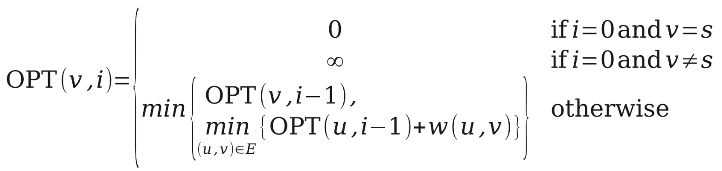
The Bellman-Ford Algorithm
Dynamic programming …

Slide 244
Dynamic Programming
Two approaches for DP: bottom-up and top-down.
Bottom-up iterates through problems by size and solves the small problems
first (Bellman-Ford solves d⁽⁰⁾ then d⁽¹⁾ then d⁽²⁾, etc.)
Top-down recurses to solve smaller problems, which recurse to solve even
smaller problems.
How is this different than divide and conquer? Memoization, which keeps
track of the small problems you’ve already solved to prevent resolving the
same problem more than once.

Slide 245
Top-Down BF Algorithm
def recursive_bellman_ford(G):
d^{(k)} = [None] * |V| for k = 0 to |V|-1
d⁽⁰⁾[v] = ∞ for all v ≠ s
d⁽⁰⁾[s] = 0
for b in V:
recursive_bf_helper(G, b, |V|-1)
def recursive_bf_helper(G, b, k):
A = {a such that (a, b) in E} ∪ {b}
for a in A:
if d^{(k-1)}[a] not None:
d^{(k-1)}[a] = recursive_bf_helper(G, a, k-1)
return min{d^{(k-1)}[b], min_{a}{d^{(k-1)}[a] + w(a, b)} }
Runtime: O(|V||E|)

Slide 246
Visualization of Top-Down
d^{(|V|-1)}[u]
d^{(|V|-1)}[v]
d^{(|V|-2)}[a]
d^{(|V|-2)}[a]
d^{(|V|-2)}[a]
d^{(|V|-2)}[a]
d^{(|V|-2)}[x]
d^{(|V|-2)}[y]
d^{(|V|-2)}[a]
d^{(|V|-2)}[a]
d^{(|V|-2)}[x]
d^{(|V|-3)}[z]
d^{(|V|-3)}[t]
d^{(|V|-3)}[v]
d^{(|V|-3)}[z]
d^{(|V|-3)}[t]
d^{(|V|-3)}[v]

Slide 247
Example 2

Slide 248
_{v₁} -3
v₂
-1
2
1
1 _{v₄}
v₃

Slide 249
_{v₁} -3
v₂
-1
2
1
1 _{v₄}
v₃

Slide 250
_{v₁} -3
 | v₁ | v₂ | v₃ | v₄
3
2
1
0
v₂
-1
2
1
1 _{v₄}
v₃

Slide 251
 | v₁ | v₂ | v₃ | v₄
3
2
1
0
_{v₁} -3
v₂
-1
2
1
1 _{v₄}
v₃

Slide 252
 | v₁ | v₂ | v₃ | v₄
3
2
1
0 | 0 | ∞ | ∞ | ∞
_{v₁} -3
v₂
-1
2
1
1 _{v₄}
v₃

Slide 253
 | v₁ | v₂ | v₃ | v₄
3
2
1
0 | 0 | ∞ | ∞ | ∞
_{v₁} -3
v₂
-1
2
1
1 _{v₄}
v₃

Slide 254
 | v₁ | v₂ | v₃ | v₄
3
2
1 | 0
0 | 0 | ∞ | ∞ | ∞
_{v₁} -3
v₂
-1
2
1
1 _{v₄}
v₃

Slide 255
 | v₁ | v₂ | v₃ | v₄
3
2
1 | 0 | -3
0 | 0 | ∞ | ∞ | ∞
_{v₁} -3
v₂
-1
2
1
1 _{v₄}
v₃

Slide 256
 | v₁ | v₂ | v₃ | v₄
3
2
1 | 0 | -3 | 2
0 | 0 | ∞ | ∞ | ∞
_{v₁} -3
v₂
-1
2
1
1 _{v₄}
v₃

Slide 257
 | v₁ | v₂ | v₃ | v₄
3
2
1 | 0 | -3 | 2 | ∞
0 | 0 | ∞ | ∞ | ∞
_{v₁} -3
v₂
-1
2
1
1 _{v₄}
v₃

Slide 258
 | v₁ | v₂ | v₃ | v₄
3
2
1 | 0 | -3 | 2 | ∞
0 | 0 | ∞ | ∞ | ∞
_{v₁} -3
v₂
-1
2
1
1 _{v₄}
v₃

Slide 259
 | v₁ | v₂ | v₃ | v₄
3
2 | 0
1 | 0 | -3 | 2 | ∞
0 | 0 | ∞ | ∞ | ∞
_{v₁} -3
v₂
-1
2
1
1 _{v₄}
v₃

Slide 260
 | v₁ | v₂ | v₃ | v₄
3
2 | 0 | -3
1 | 0 | -3 | 2 | ∞
0 | 0 | ∞ | ∞ | ∞
_{v₁} -3
v₂
-1
2
1
1 _{v₄}
v₃

Slide 261
 | v₁ | v₂ | v₃ | v₄
3
2 | 0 | -3 | 2
1 | 0 | -3 | 2 | ∞
0 | 0 | ∞ | ∞ | ∞
_{v₁} -3
v₂
-1
2
1
1 _{v₄}
v₃

Slide 262
 | v₁ | v₂ | v₃ | v₄
3
2 | 0 | -3 | 2 | -2
1 | 0 | -3 | 2 | ∞
0 | 0 | ∞ | ∞ | ∞
_{v₁} -3
v₂
-1
2
1
1 _{v₄}
v₃

Slide 263
 | v₁ | v₂ | v₃ | v₄
3
2 | 0 | -3 | 2 | -2
1 | 0 | -3 | 2 | ∞
0 | 0 | ∞ | ∞ | ∞
_{v₁} -3
v₂
-1
2
1
1 _{v₄}
v₃

Slide 264
 | v₁ | v₂ | v₃ | v₄
3 | 0
2 | 0 | -3 | 2 | -2
1 | 0 | -3 | 2 | ∞
0 | 0 | ∞ | ∞ | ∞
_{v₁} -3
v₂
-1
2
1
1 _{v₄}
v₃

Slide 265
 | v₁ | v₂ | v₃ | v₄
3 | 0 | -3
2 | 0 | -3 | 2 | -2
1 | 0 | -3 | 2 | ∞
0 | 0 | ∞ | ∞ | ∞
_{v₁} -3
v₂
-1
2
1
1 _{v₄}
v₃

Slide 266
 | v₁ | v₂ | v₃ | v₄
3 | 0 | -3 | -1
2 | 0 | -3 | 2 | -2
1 | 0 | -3 | 2 | ∞
0 | 0 | ∞ | ∞ | ∞
_{v₁} -3
v₂
-1
2
1
1 _{v₄}
v₃

Slide 267
 | v₁ | v₂ | v₃ | v₄
3 | 0 | -3 | -1 | -2
2 | 0 | -3 | 2 | -2
1 | 0 | -3 | 2 | ∞
0 | 0 | ∞ | ∞ | ∞
_{v₁} -3
v₂
-1
2
1
1 _{v₄}
v₃

Slide 268
Analyzing Space Complexity
●
What is the space complexity of this algorithm?
Create a table DP of size n × n. Set DP[v][0] = ∞ for all v ≠ s.
Set DP[s][0] = 0
For i = 1 to n – 1, for all v ∈ V:
– Set DP[v][i] = min {
DP[v][i – 1],
min { DP[u][i – 1] + w(u, v) } (where (u, v) ∈ E)
}
Return row n of DP.
●
●
●
●
●
●
Answer: O(n²). (Can we reduce this?)

Slide 269
Linear Programming and
Bellman-Ford Algorithm
LINEAR PROGRAMMING(LP)
given: an mxn constraint matrix A & an mx1 bound vector b & an nx1 cost vector c
problem : find an n-vector x that maximizes c^{T}x subject
n
n
A
b
x
m
n
m
maximizing
C
T
x
n

Slide 270
Linear Programming and
Bellman-Ford Algorithm
Linear feasibility:
    satisfy m linear constraints : Σ a_{ij} ≤ b_{i}
    for i = 1,2,...,m
Linear optimization:
    maximize the linear cost(objective) function: Σ λϕξϕ
General algorithms:
    simplex: practical, but worst-case is exponential
    ellipsoid: theoretical, polynomial time
    Karmarkar: polynomial time, practical
ν
ι = 1
ν
ι = 1

Slide 271
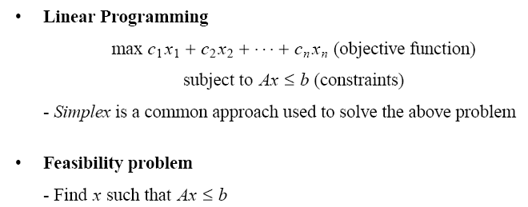
Application: Feasibility Problem

Slide 272
Application: Feasibility Problem (cont.)

Slide 273
Application: Feasibility Problem (cont.)

Slide 274

Application: Feasibility Problem (cont.)
-1
x₁
0
x₂
5
0
4
0
x₀
0
1
x₃
0
-1
0
-3
x₅
x₄
-3

Slide 275
Application: Feasibility Problem (cont.)
0
-1
X₁
0
0
X₂
0
5
4
0
0
X₀
0
X₃
0
1
-1
-3
0
X₄
0
0
-3
X₅

Slide 276
Application: Feasibility Problem (cont.)
0
-1
X₁
0
0
X₂
0
5
4
0
0
X₀
0
X₃
0
1
-1
-3
0
X₄
0
0
-3
X₅

Slide 277
Application: Feasibility Problem (cont.)
0
-1
X₁
0
0
X₂
0
5
4
0
0
X₀
0
X₃
0
1
-1
-3
0
X₄
0
0
-3
X₅

Slide 278
Application: Feasibility Problem (cont.)
0
-1
X₁
0
0
X₂
0
5
4
0
0
X₀
0
X₃
0
1
-1
-3
0
X₄
-1
-3
-3
X₅

Slide 279
Application: Feasibility Problem (cont.)
0
-1
X₁
0
0
X₂
0
5
4
0
0
X₀
0
X₃
0
1
-1
-3
0
X₄
-1
-4
-3
X₅

Slide 280
Application: Feasibility Problem (cont.)
-5
-1
X₁
0
-3
X₂
0
5
4
0
0
X₀
0
X₃
0
1
-1
-3
0
X₄
-1
-4
-3
X₅

Slide 281
Application: Feasibility Problem (cont.)
Size of the constraint graph
If we have m constraints with n unknowns
(Ax ≤ b, A is m x n)
V = n + 1 and E = m + n
Running time:
O(VE) = O(n + 1) (m + n))
= O(n² + n m)

